Slide 1


Machine Learning: A Beginner's Guide
Machine Learning (ML) is a powerful area of Artificial Intelligence (AI) that helps machines learn from data and make predictions or decisions without explicit programming.
by Zeeshan Zafar

Slide 2

Applications of Machine Learning in 2024
Healthcare
Finance
Predictive analytics for patient outcomes, early disease diagnosis, and personalized treatment plans.
Fraud detection, predicting stock trends, and optimizing portfolios.
Retail
Transportation
Personalized product recommendations and inventory management through demand forecasting.
Enhancing self-driving car navigation and optimizing delivery routes.
General Examples
Netflix/You tube recommendations
Google Search Engine
Alexa, Siri ( Voice recognition )
Chatbots ( Chatgpt, MetaAi, Gemini, Claude )

Slide 3
Types of Machine Learning
Supervised Learning
Unsupervised Learning
Reinforcement Learning
Trains models on labeled datasets with input-output relationships.
Discovers patterns and structures in unlabeled data.
Machines learn through trial-and-error interactions with an environment.

Slide 4

Supervised Learning
1
Common Algorithms
2
Applications
Regression and classification algorithms like Linear Regression, Logistic Regression, and Decision Trees.
Email spam filtering
Predictions
Image Classification

Slide 5



Unsupervised Learning
Clustering
Dimensionality Reduction
K-Means, Hierarchical Clustering, and DBSCAN.
PCA and t-SNE techniques.
Examples: Customer Segmentation, Anomaly Detection
Example: Image Compression

Slide 6

Reinforcement Learning
1
Agents
Autonomous entities that interact with an environment.
2
Rewards
Feedback received by agents for performing actions.
3
Policies
Strategies that guide agent actions to maximize rewards.

Slide 7
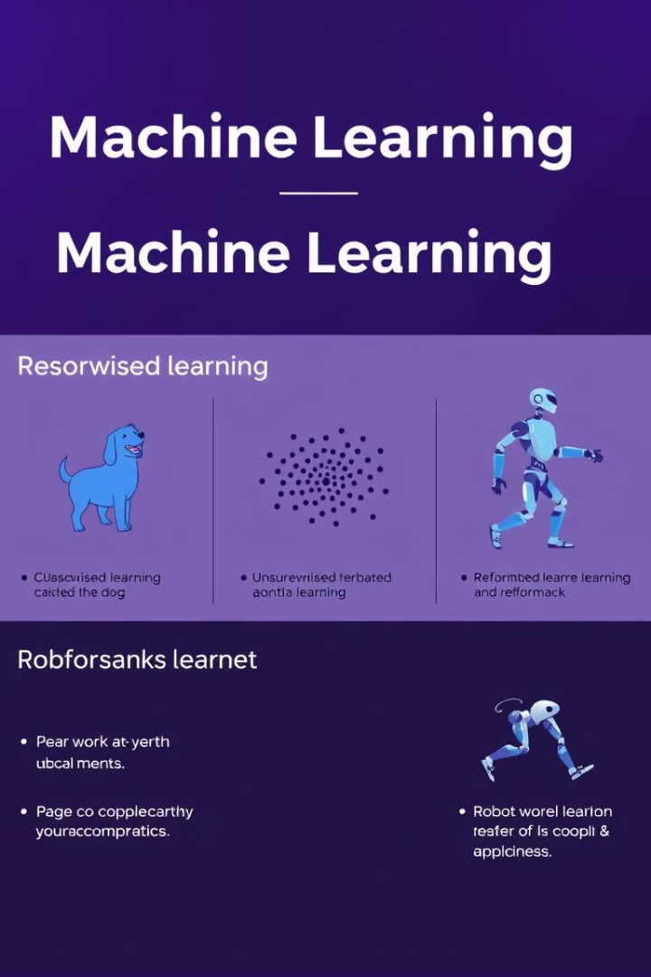
Comparative Examples
Type
Technique/Algorithm
Example
Supervised
Linear Regression
Predicting house prices
Unsupervised
K-Means
Customer segmentation
Reinforcement
Q-Learning
AI mastering chess or Go

